Slide 1

Team Gravity
Scale Focus Sprint

Slide 2
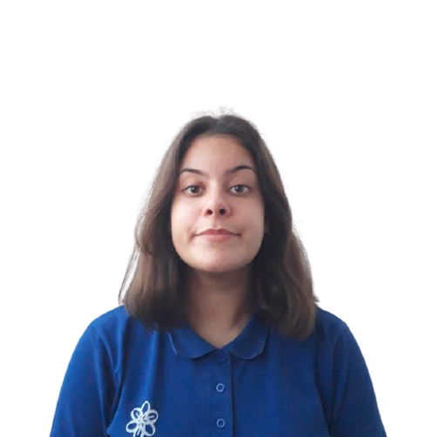
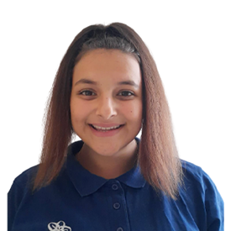
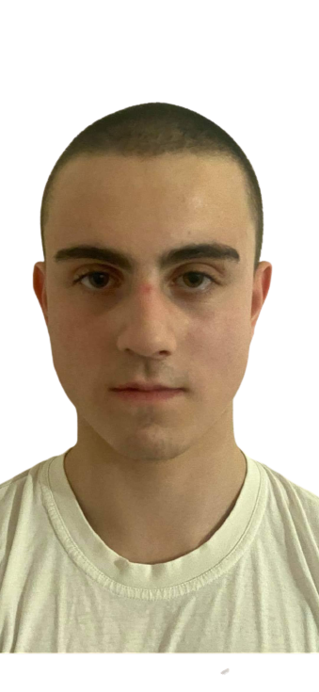
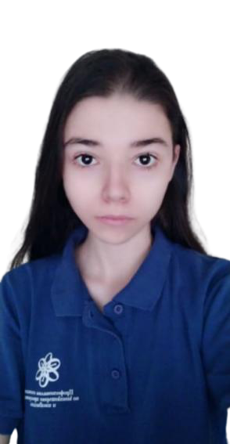
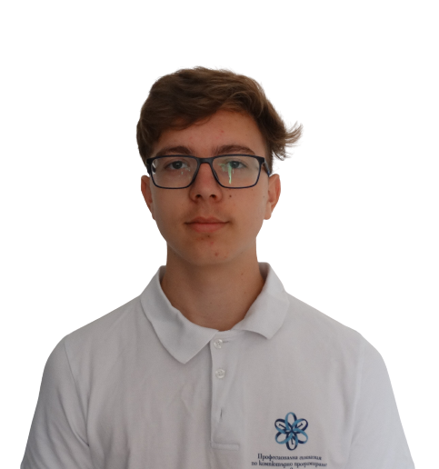
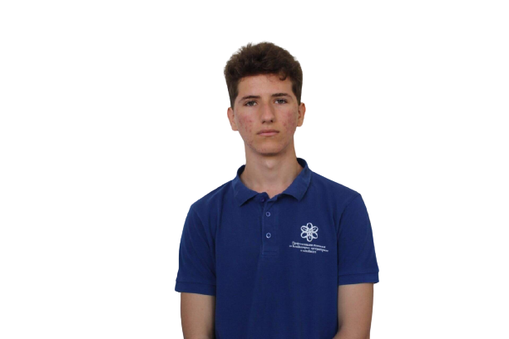
Our team
Radina Velichkova
Scrum Trainer
Stanislava Andonova
Quality engineer
Kristina Bolashikova
Developer Back-End
Martin Tsifundarov
Developer Front-End
Alex Patrashkov
Code Checker
Dani Dimov
Documentary

Slide 3
OUR GOAL

Slide 4



STAGES OF REALIZATION

Slide 5
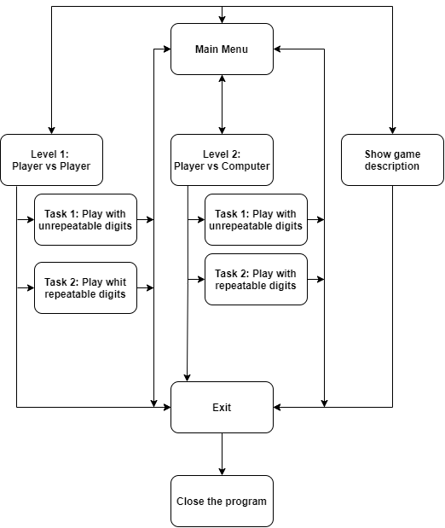
FLOWCHART

Slide 6









USED TECHNOLOGIES

Slide 7
QUALITY ASSURANCE

Slide 8
DEMONSTRATION

Slide 9
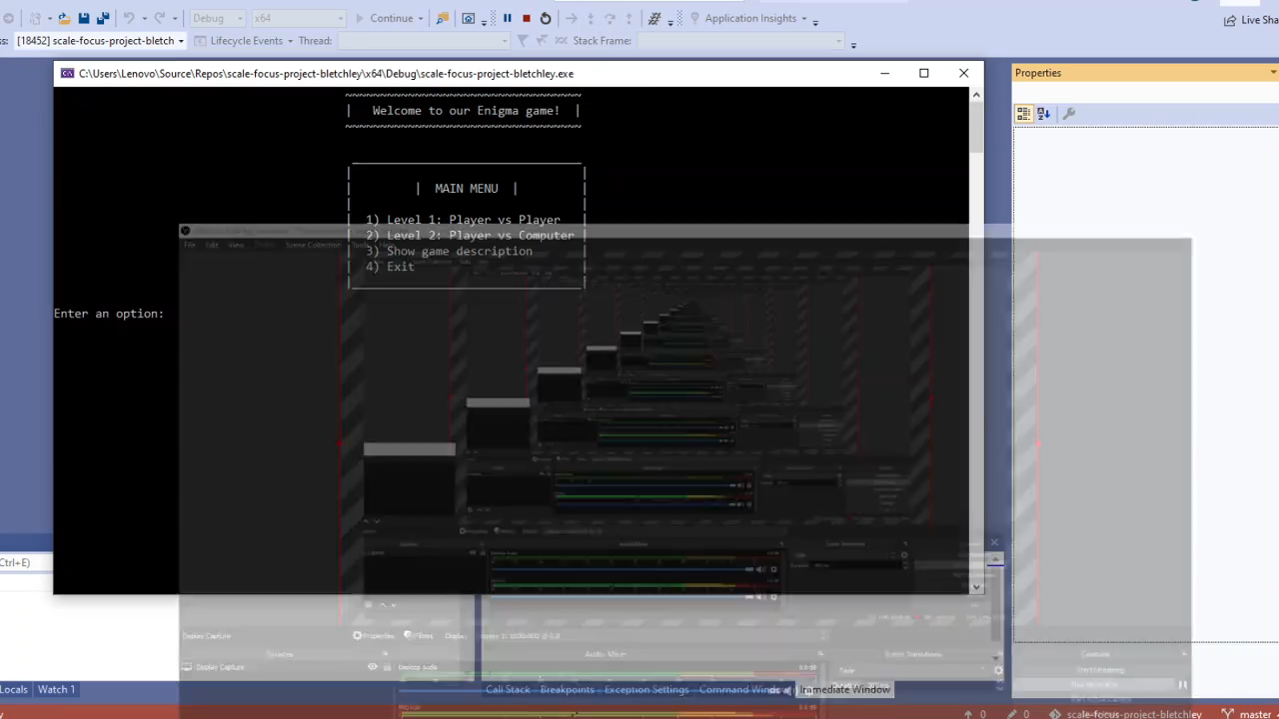

Slide 10
FUTURE PLANS

Slide 11
Thank YOU FOR THE ATTENTION!

